Slide 1
Python Projects on Optimization
By Tanmoy Das
(Industrial Engineer & Jr. Data Scientist)

Slide 2
Network Optimization

Slide 3
Travelling Salesman Problem

Slide 4
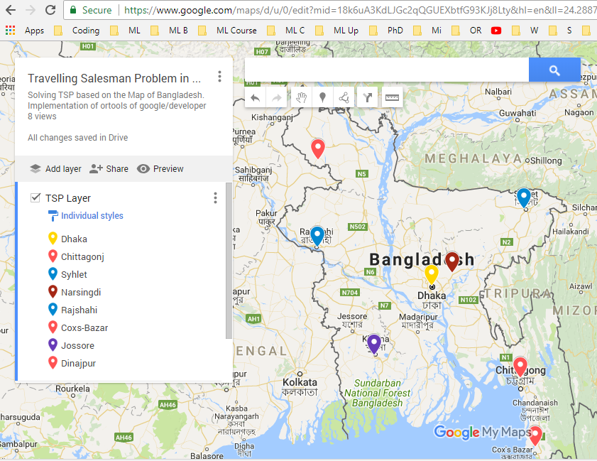

Slide 5
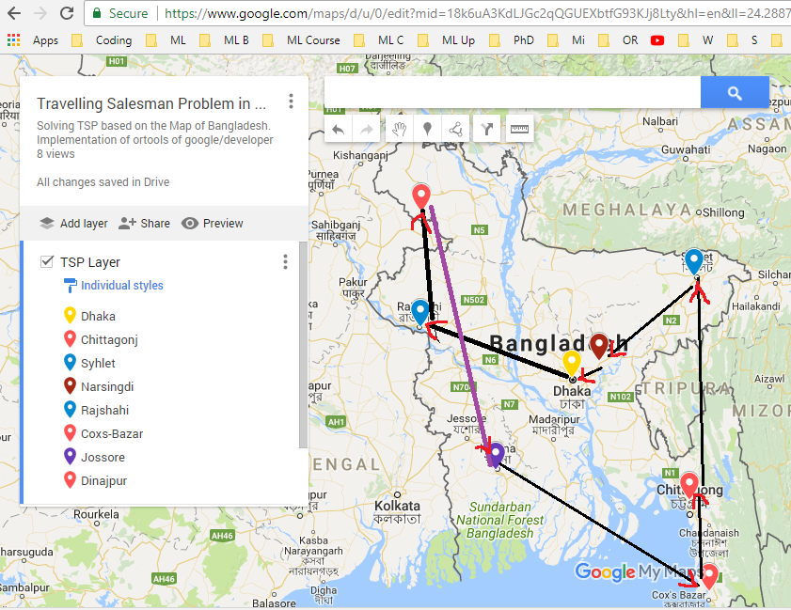
Dnj
Slt
Raj
Nsd
Dhk
Jsr
Cht
Cox

Slide 6
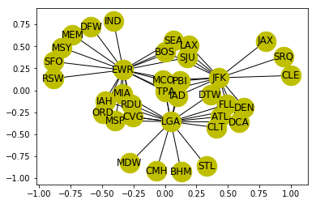
Draw the Network of the airlines problem Find the Shortest path from JAX to DFW
DFW
JAX
https://www.kaggle.com/tanmoyie/traveling-salesman-problem

Slide 7
Network Optimization: Airlines Optimization Problem
Import the libraries
Import the dataset
Data processing (e.g. date, time)
from_pandas_edgelist(data, source='origin', target='dest', edge_attr=True,)
Add node, edge & draw the network
Determine the unique sources
Find shorted path between Jacksonville International Airport to Dallas/Fort Worth International Airport

Slide 8
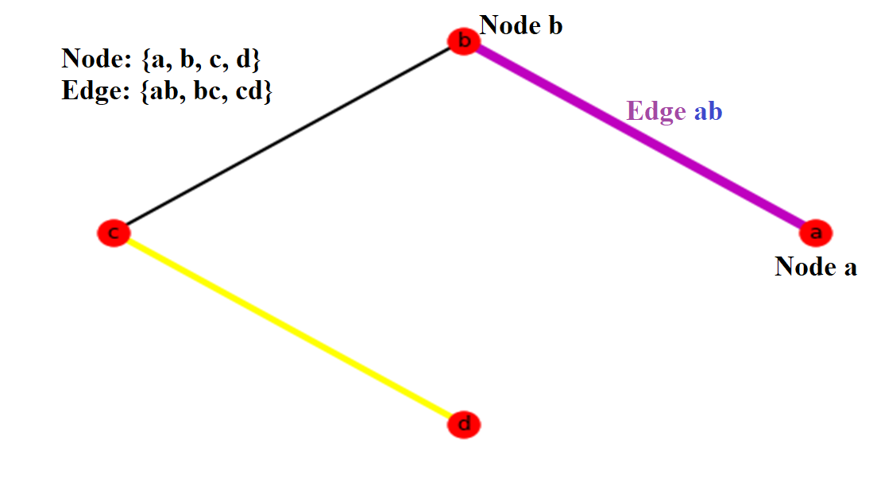

Slide 9
Network Optimization: Draw a Simple Network
Import networkx package
Explore the Network Optimization algorithms in NetworkX (e.g. Dijsktra, Min Cost Flow, MST)
Draw an empty graph
Add the edges & their properties
Color & display stuffs
Draw the Network
This explanation is ran on Spider IDE in Anaconda distribution
IF you don’t see the expected variables in the variable explorer tab, click option in the variable explorer tab, & click “exclude unsupported data type” or others.
https://github.com/tanmoyie/Operations-Research

Slide 10
Transportation Problem in Operations Research (Optimization)

Slide 11
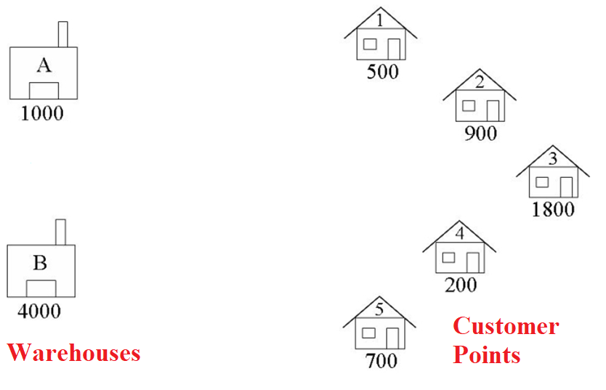
Transportation
Solving a Transportation problem

Slide 12
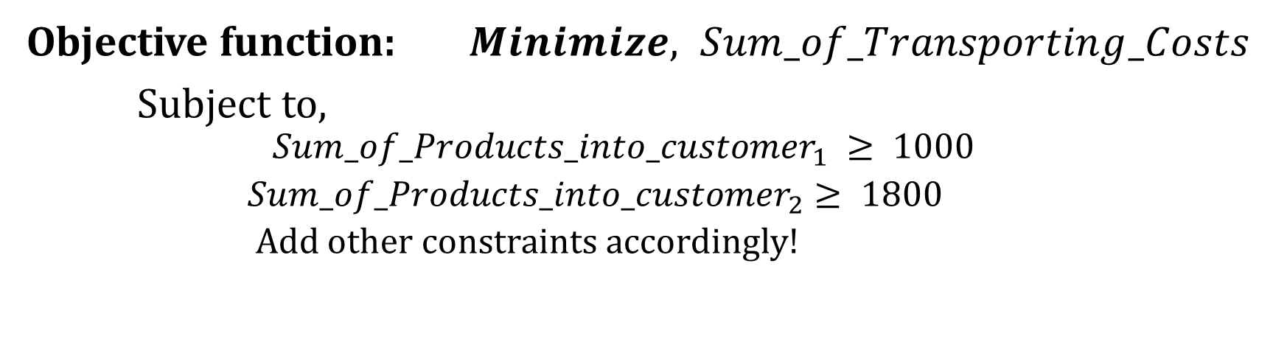
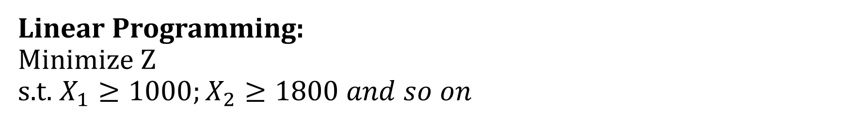
Linear Programming: Minimize Z s.t. $X_{1}≥1000;X_{2}≥1800 and so on$
Objective function: $Minimize, Sum_of_Transporting_Costs$
Subject to,
$$Sum_of_Products_into_customer_{1} ≥ 1000$$
$Sum_of_Products_into_customer_{2}≥ 1800$
Add other constraints accordingly!

Slide 13
Linear Regression in Machine Learning
Import libraries
Load the dataset
Create linear regression object
Train the model using the training sets
Make predictions using the testing set

Slide 14
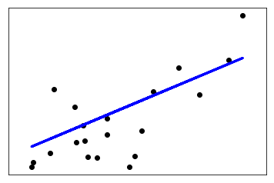

Slide 15
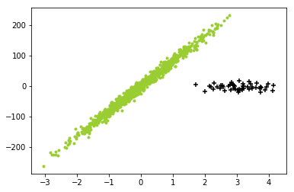
Robust Regression in Machine Learning

Slide 16
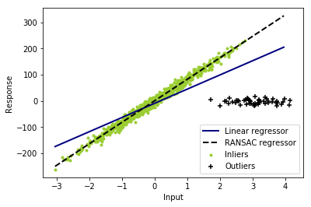

Slide 17
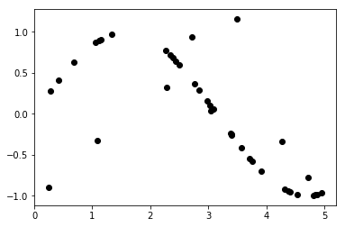
Support Vector Machine in Machine Learning

Slide 18
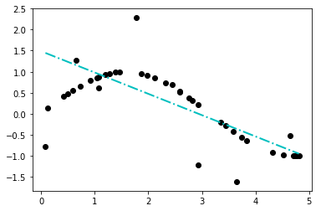

Slide 19
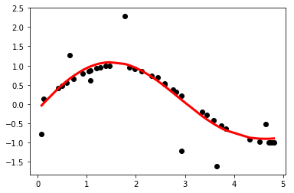

Slide 20
